Slide 1
Korean Lake Ecological Observatory Network
Buyoung Ahn, Youngjin Kim, Jongsuk Lee and Kum Won Cho
Dept. of Cyber Environment Development, KISTI
Bumcheol Kim
Dept. of Environmental Science,
Kangwon National University

Slide 2
Content
Goal
Organization
Roles of KISTI and KNU
Ecosystem Monitoring Testbed
Installing Sensor Network
Sensors in Lake Soyang and Lake Euiam
Expected Effect of KLEON

Slide 3
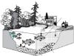
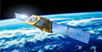
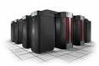
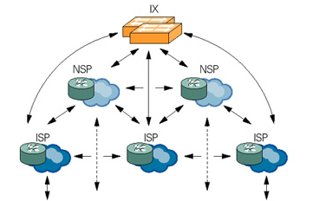
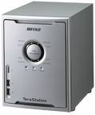
1. Goal of KLEON
Establishment of ecological observatory network in lakes and rivers
Supporting Global Joint Ecology
Research Environment
Global Joint Research
Environment/Ecology analysis
Summary, Analysis and Prediction
of Observation
KLEON
(Web)
Using Result for
Environment Preservation Policy
/Teaching Resource
Sharing Ecology
Observation/ Information
Construction of Observation Infrastructure
Construction of KLEON (Korean Lake/Reservoir Ecological Observation Network)
Data Standardization
Data Convergence
Visualization
Simulation Model
KISTI Cyber Infrastructure
Computing Resource
High performance Network
large-capacity Storage

Slide 4
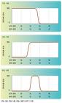
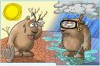
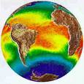
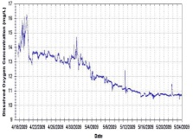
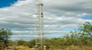


2. Organization of KLEON
Collection of Global Lake/Reservoir Observation Data
Construction of Global Joint Research Network
With Global e-Science Gateway
Using Result for Environment Preservation Policy /Teaching Resource
Sharing Ecology
Observation/ Information
Supporting Global Joint Ecology
Research Environment
Domestic observation
(Lake Soyang, Lake Uiam,
Han river, Swamp Upo)
Web Service
Ecologist/Statistician
(KNU, CNU)
Request of data, information
Requested data, information
Observation
KLEON testbed
Information
/Knowledge
Ecosystem
assessment
User query
processor
Data
convergence
Data
standardization
Data analysis
& prediction
Visualization
Simulation
model
Simulation
modeling
Global Observation
(USA, New Zealand, Thailand)
Request of data, information
Requested data, information
Data analysis &
prediction
KISTI Cyber infrastructure
Computing
Resource
Large-capacity
storage
High performance
network
Raw/meta
data
Analyzed
data
Ecology
model

Slide 5
3. Roles of KISTI and KNU
Kangwon National University | Dept. of Cyber Environment Development of KISTI
Building Web portal Real time sensor data (High frequency) Provide the observation data Construction of sensor network Lake (Soyang, Uiam) Swamp Upo River (Han, Anyang, Soyang) Global Cooperation GLEON, KEON Application Water quality modeling using CE-QUAL-W2 | Supporting IT Infrastructure Server, Large-capacity storage, High performance network Constructing the database for sensor data management Raw data for 30 years Metadata(standardization, share) Developing GUI interface Simulation model presentation based on Google earth Global Cooperation & IT support GLEON, KEON Survey of IT Techniques for Ecosystem CUAHSI (Consortium of Universities for the Advancement of Hydrologic Science) GLEON (Global Lake Ecological Observatory Network) OGC (Open Geospatial Consortium)

Slide 6
4. Ecosystem Monitoring Testbed
Testbed for monitoring ecosystem in Lakes and Reservoirs
Install sensors such as water temperature, DO, turbidity
Real time observed data management
Sensors
Water temperature, Electrical Conductivity, Dissolved Oxygen, pH, Turbidity
Sensor management
Clean and measurement adjustment per every week
Real time sensor data transmission for monitoring three sites
Storing the real time data to database
Transmission efficiency comparison between RF model type and CDMA modem
Regular data download for monitoring other sites

Slide 7
5. Installing Sensor Network
Table 1. Sensor type, Data collection method, and Analysis
Target Place | Sensor type | Data collection method | Analysis
1. Lake Soyang | Troll multiprobe | Real time data transmission | Eutrophication Evaluation
 | (Water temperature, DO, Electrical Conductivity) | RF-modem
2. Lake Uiam | combination sensor | Real time data transmission | Eutrophication Evaluation, Turbid water evaluation
 | (Water temperature, DO, Electrical Conductivity, Turbidity) | RF-modem
3. Anyang River | Troll multiprobe | Real time data transmission | Analysis of causes of Fish Kill by Oxygen deficit
 | (Water temperature, DO, pH, Electrical Conductivity) | CDMA modem
4. Swamp Upo | Hydrolab | Regular download | Eutrophication Evaluation
 | (Water temperature, DO, Electrical Conductivity)
5. Soyang River | Hydrolab (Water temperature, Electrical Conductivity, Turbidity) | Regular download | Turbid water evaluation
6. Han River | Hydrolab (Water temperature, Electrical Conductivity) | Regular download | Long term Ecological Research, Climate Change,
 |  |  | Eutrophication Evaluation,
7. Gapyeong River | Hydrolab (Water temperature, Electrical Conductivity) | Regular download | Long term Ecological Research, Climate Change

Slide 8
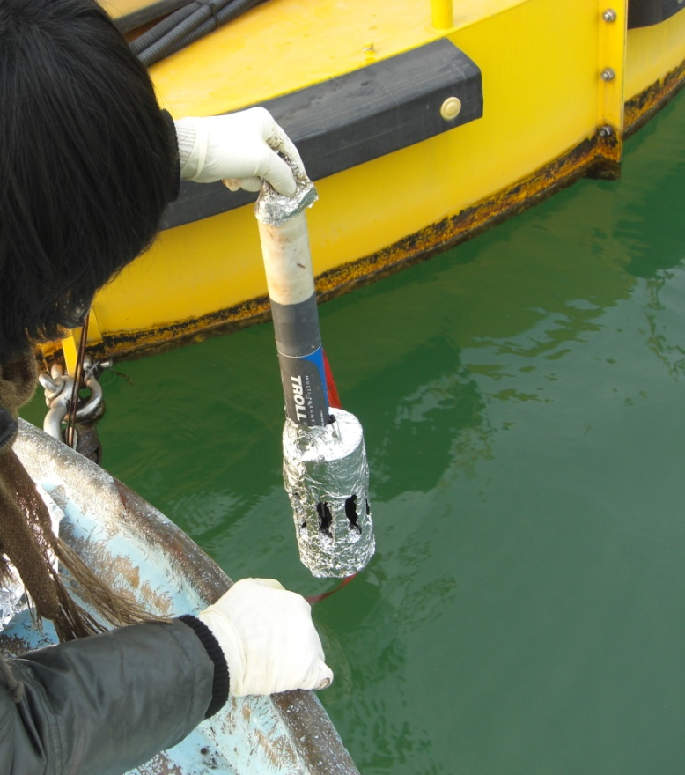
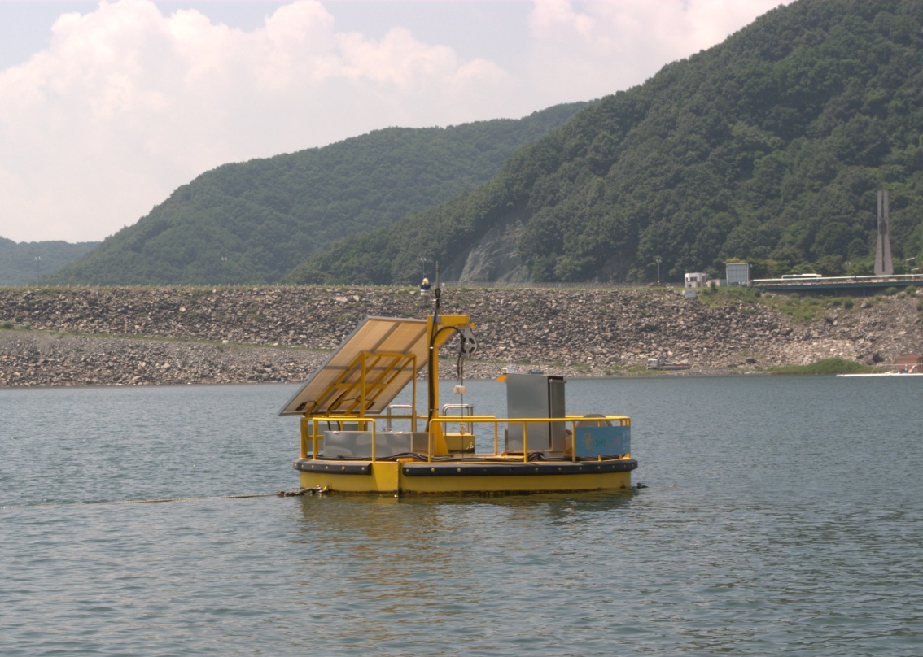
6. Buoy sensor in Lake Soyang
Troll sensor – DO, turbidity, temp, conductivity per every 5minutes
Buoy platform was installed by K-water

Slide 9
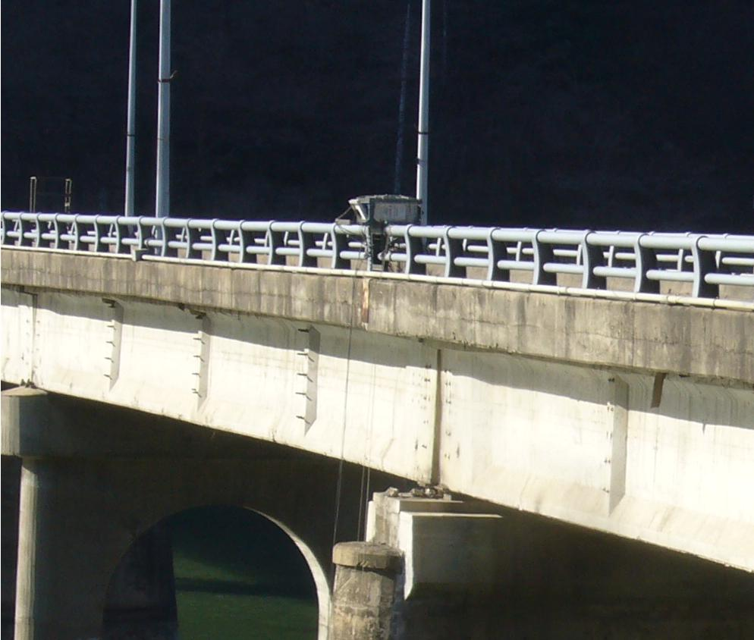
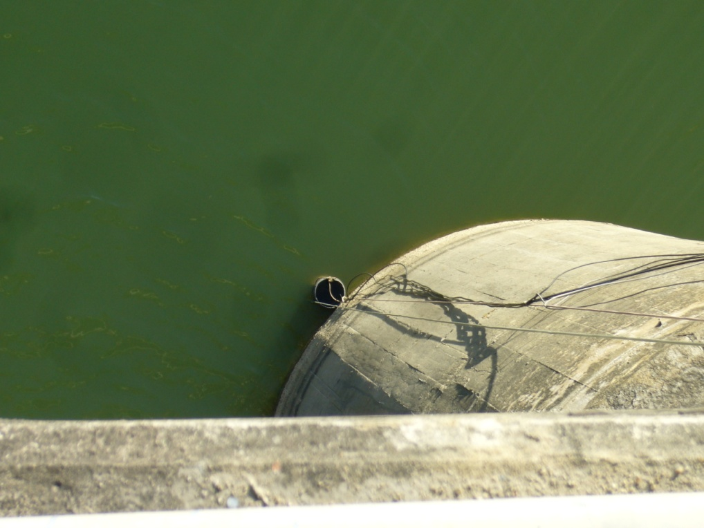
6. Sensors in Lake Euiam
DO, Temp, turbidity, conductivity sensors
Weekly cleaning of sensors

Slide 10
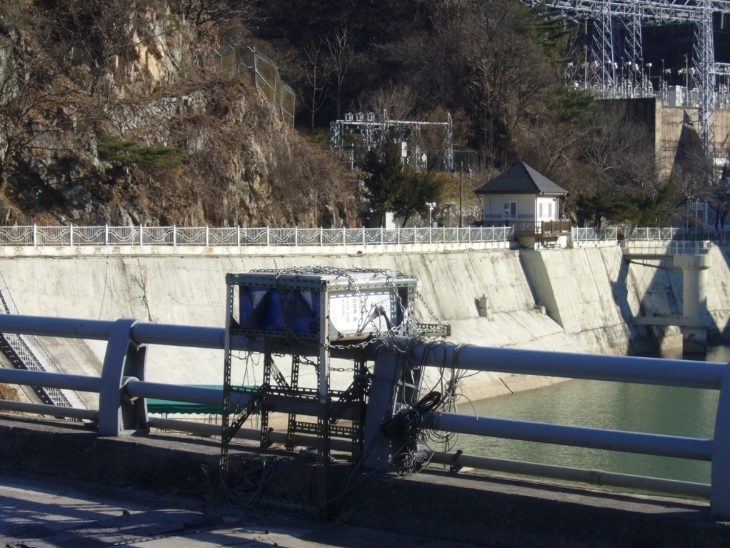
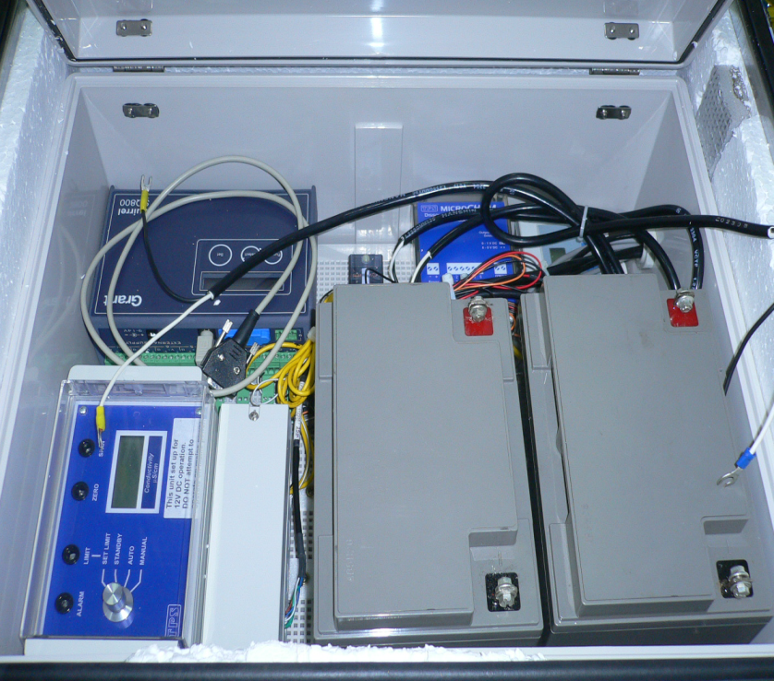
6. Sensors in Lake Euiam
Controller
DO meter
Conductivity
Turbidity
battery
sensors installed on a bridge
not connected to internet

Slide 11
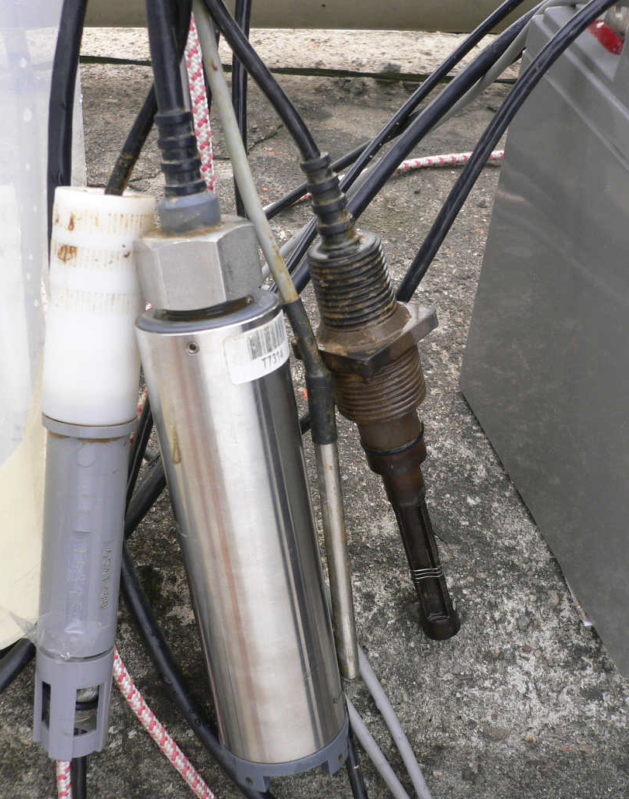
6. Sensors
Temperature (Air, Water)
Thermometer
Dissolved Oxygen(YSI 55)
Turbidity
Conductivity(miniCHEM)
Data logger
Thermometer
Turbidity
sensor
DO sensor
Conductivity sensor

Slide 12
7. Expected Effect of KLEON
Community | National Policy
Global Cooperation & IT support Korea : KEON, KLTER, Long Term Ecological Research, K-water Global: GLEON | Environment preservation policy Green Development Pollution prevention
Science | IT
Environment/Ecology Research development (data accumulation & modeling) Improving the accuracy of water quality model Teaching Resource | Real time data management for Ecological Research Data standardization Data integration with Climate data Visualization & Simulation

Slide 13
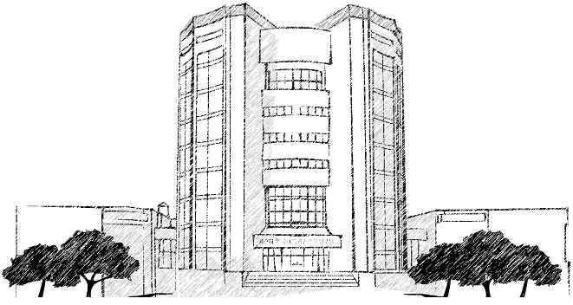

Thank You

